Slide 1


Slide 2

Personal Fitness Tracker
Computer Science
CS519
Associate Degree Program (ADP)

Slide 3
Introduction
Name: Ali Hasnain
VU ID: BC230411456

Slide 4
Introduction of Project
The Personal Fitness Tracker is a web-based application that helps users manage fitness activities and monitor health progress. Unregistered users can view general tips and routines, while registered users can log workouts, meals, and water intake, and track progress through charts. Trainers interact with users by giving feedback and suggestions, and admins manage users, trainers, and public content

Slide 5
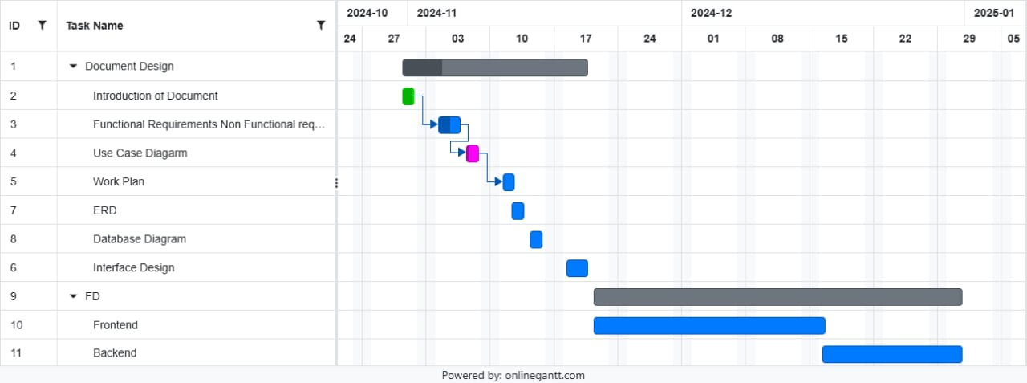
Project Schedule

Slide 6
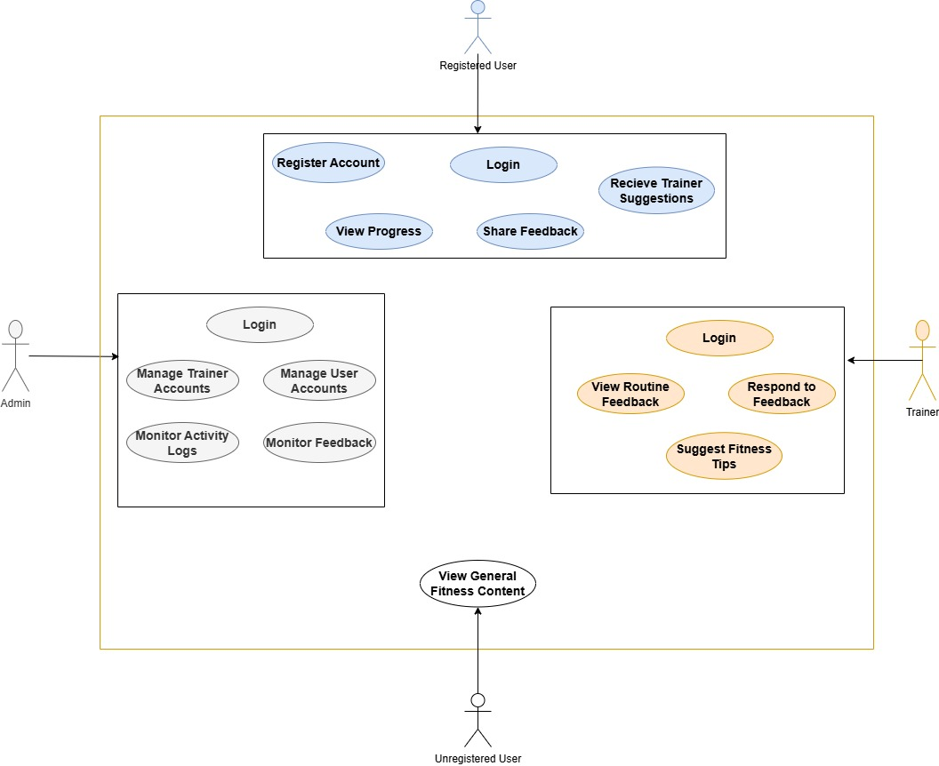
Use Case Diagram

Slide 7
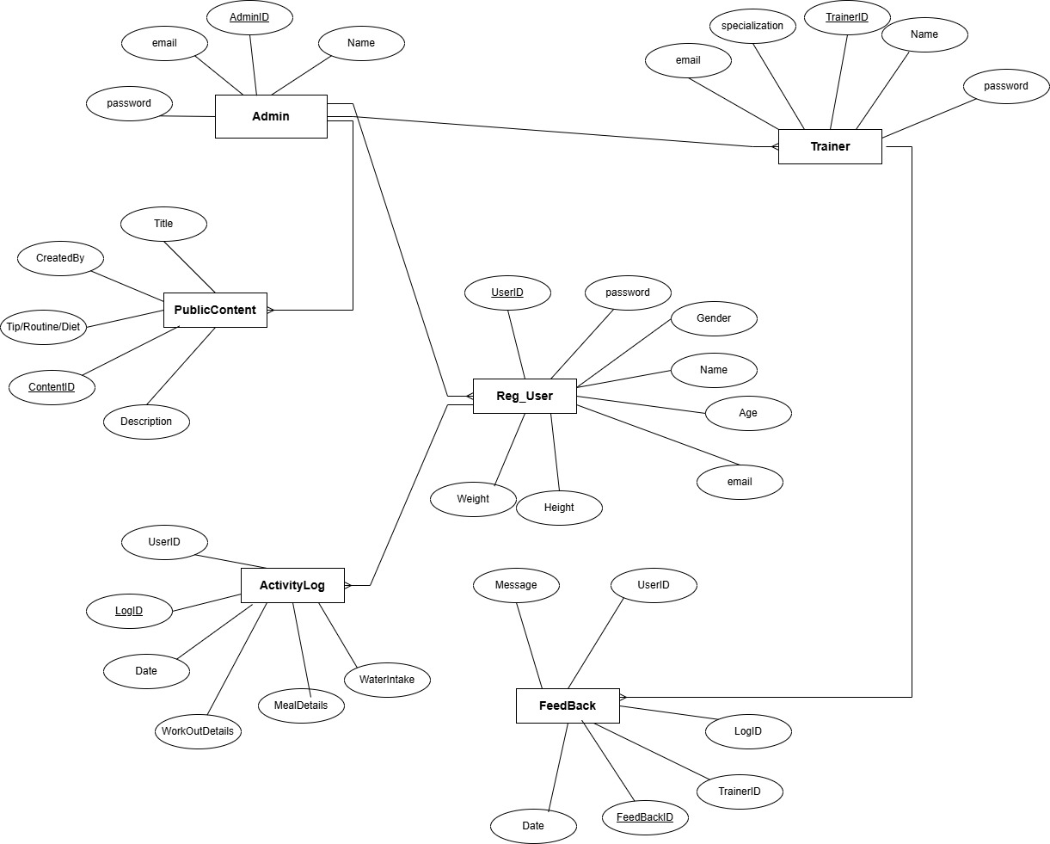
Entity-Relationship Diagram

Slide 8
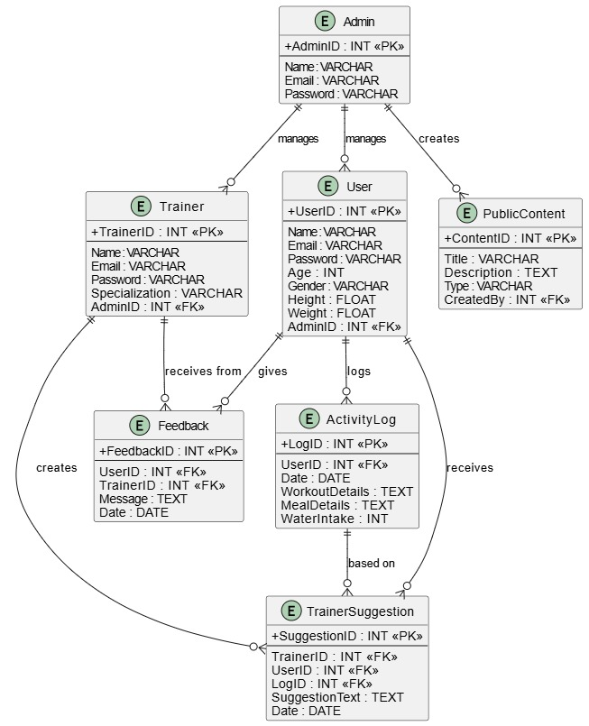
Relational Schema

Slide 9
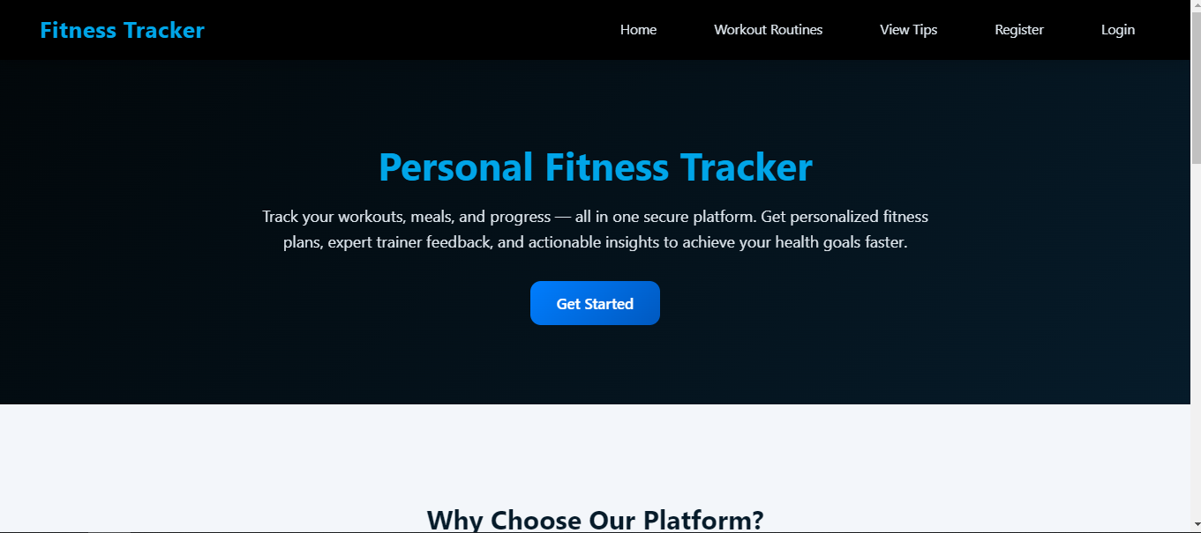
User Interfaces

Slide 10
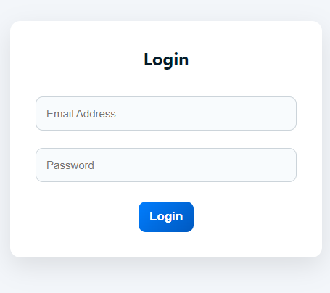
User Interfaces

Slide 11
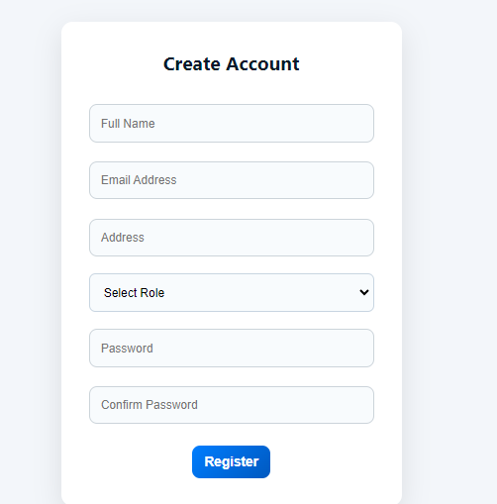
User Interfaces

Slide 12
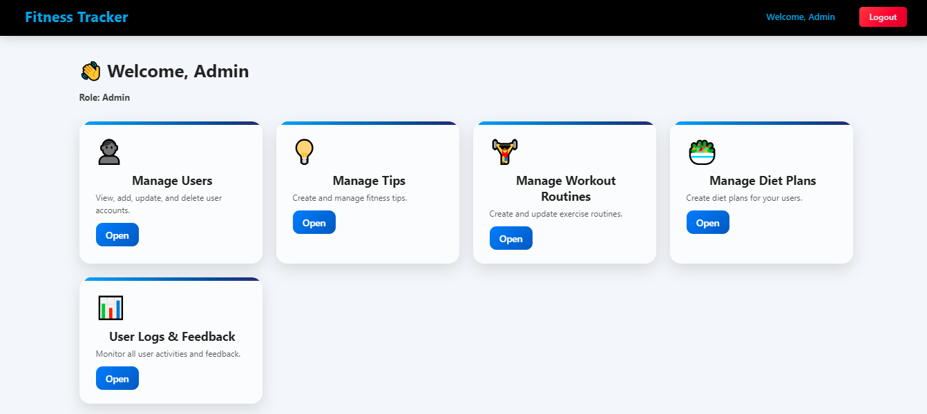
User Interfaces

Slide 13
Tools
Html
CSS
PHP
Xampp (MYSQL (Database))

Slide 14
Thank you

